Slide 1



Cyber Threat Intelligence Mining for Proactive Cybersecurity Defense
Department of Computer Science and Engineering
Sustainable Development Goals-9,16,17
Team Members Name / Register Number CHERISH.S.D(211420104047) DANIEL DANE.N.K(211420104050) GOKKUL SANTHOSH.Y(211420104080)
Guide Name & Designation
Mrs. D. JENNIFER M.E
Coordinator Name & Designation
Dr. N.PUGHAZENDI M.E, PhD
1

Slide 2
Introduction
In today's rapidly evolving digital landscape, the frequency and severity of cyber attacks have escalated, necessitating innovative approaches to cybersecurity.
Traditional security systems reliant on heuristics and signatures struggle to contend with the intricate nature of modern threats.
This project aims to explore and leverage CTI mining techniques to develop an advanced threat intelligence framework.
By comprehensively analyzing cyber threat data, this framework will empower organizations to bolster their security measures, identify emerging threats, and respond effectively.

Slide 3
Objective of the Project
The aim of the system is to capture the essence of using CTI mining to improve cybersecurity by developing a more comprehensive and proactive approach to threat detection and response.
It also emphasizes the goal of utilizing CTI insights to strengthen security postures and address the challenges posed by modern cyber threats.

Slide 4
Problem Statement
In the face of escalating and intricate cyber attacks, traditional security systems are struggling to provide adequate protection
The dynamic nature of modern threats demands a new paradigm for cybersecurity. This project focuses on harnessing the potential of Cyber Threat Intelligence (CTI) mining to fortify security measures.
This framework will empower organizations to proactively identify, prevent, and respond to sophisticated cyber threats. It also highlights challenges and potential future directions in CTI mining, underscoring its vital role in strengthening cybersecurity posture in the modern digital landscape.

Slide 5
Literature Survey
YEAR | TITLE AND JOURNAL | AUTHOR | DESCRIPTION | ADVANTAGES | DISADVANTAGES
2021 | “Using manifold structure for partially labelled classification. In Advances in NIPS” | M. Belkin and P. Niyogi | The system was built on the principle of sub-manifold content. | The system can scale more effectively as the dataset grows. | The system may struggle to handle outliers or anomalies that lie outside the learned sub-manifold
2020 | Exploring threats and vulnerabilities in hacker web: Forums, and carding shops. Intelligence and Security Informatics (ISI) | V. Benjamin, W. Li, T. Holt, and H. Chen | The system is an automated process that finds concrete, verifiable evidence of possible threats in carding shops, IRC channels, and hacker forums. | The broad coverage increases the likelihood of detecting emerging threats and trends early. | Contains complex Algorithm And consuming more power

Slide 6
Existing system
In the current cybersecurity landscape, organizations rely heavily on traditional security systems that employ heuristics, signatures, and basic threat data integration.
Basic threat data feeds are integrated into network and firewall systems, intrusion prevention systems, and Security Information and Event Management systems (SIEMs), but their insights are limited and reactive.
This existing system, while serving as a foundation for cybersecurity, falls short in providing a comprehensive and proactive approach to threat detection, prevention, and response.

Slide 7
Proposed System
The proposed system aims to revolutionize cybersecurity through the implementation of an advanced Cyber Threat Intelligence (CTI) mining framework.
The proposed system will leverage diverse data sources and cutting-edge analysis techniques to provide organizations with a proactive and comprehensive approach to threat detection, prevention, and response.
By processing and analyzing CTI insights, the system will empower organizations to identify emerging threats, profile hackers, understand attack tactics, and make informed decisions to strengthen their security posture.
This proposed system will bridge the gaps in the existing cybersecurity landscape, enhancing the ability to combat complex and evolving cyber threats effectively.

Slide 8
Software / Hardware used
Operating System : Windows 10 (64 bit)
Software : Python
Tools : Anaconda
Hard Disk : 500GB and above
RAM : 8GB and above
Processor : 15 and above

Slide 9
Algorithm used
The various algorithms used are:
i. Support Vector Machine(SVM)
ii. Gradient Boost Algorithm
iii. Artificial Neural Network(ANN)

Slide 10
Modules Used
Data Collection
Pre-processing
Feature Extraction
Model prediction
User

Slide 11
Module Description
Module 1: Data Collection
The process of gathering diverse and relevant cyber threat data from various sources, such as logs, network traffic, threat feeds, and social media platforms. This module involves systematically retrieving raw data to be used for analysis and threat detection.

Slide 12
Module Description
Module 2: Pre-processing
The initial stage of data preparation where collected raw data is cleaned, transformed, and organized. This module aims to remove noise, handle missing values, standardize formats, and ensure data consistency before further analysis.

Slide 13
Module Description
Module 3: Feature Extraction
The process of selecting and transforming relevant attributes or characteristics from the pre-processed data to create meaningful features for analysis. This module involves reducing data dimensionality and extracting essential information that contributes to effective model prediction.

Slide 14
Module Description
Module 4: Model Prediction
The core analytical component where machine learning algorithms, statistical methods, or other computational techniques are applied to predict potential cyber threats based on the extracted features. This module uses historical data to build predictive models that can identify and classify emerging threats in real-time.

Slide 15
Module Description
Module 5: User-Driven Threat Prediction
The cybersecurity framework allows users to input relevant values or parameters based on their specific context or scenario. These inputs serve as the basis for predicting potential cyber threats. The framework then processes these inputs and predicts the result by employing advanced algorithms.

Slide 16
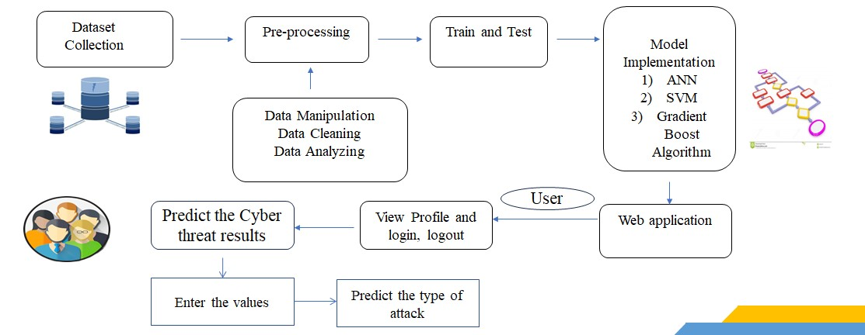
Architecture / Methodology used

Slide 17
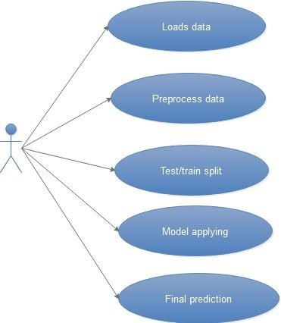
System Design –Use Case diagram

Slide 18
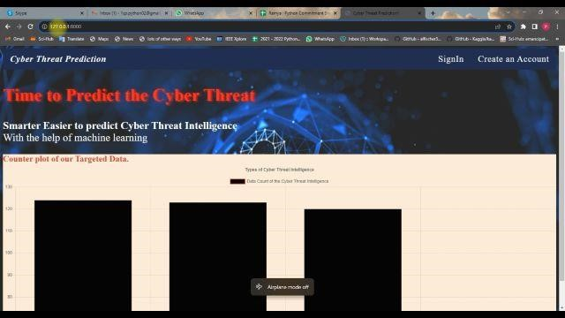
Results

Slide 19
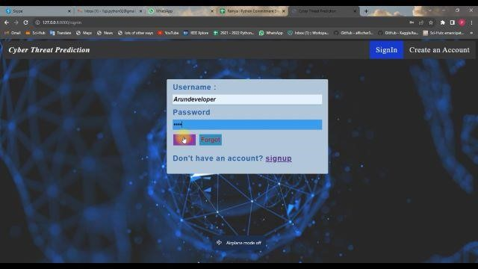
Results

Slide 20
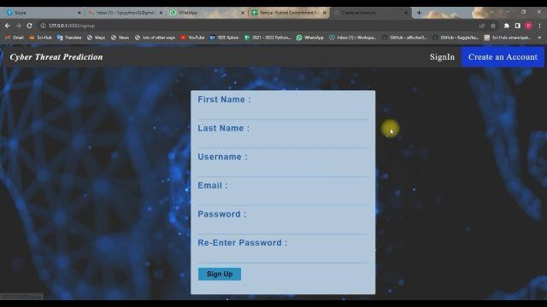
Results

Slide 21
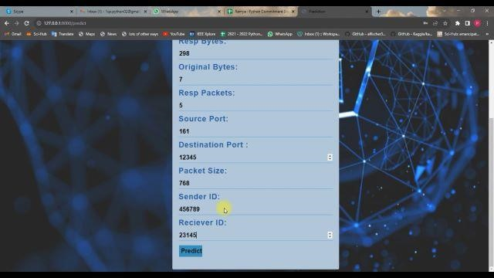
Results

Slide 22
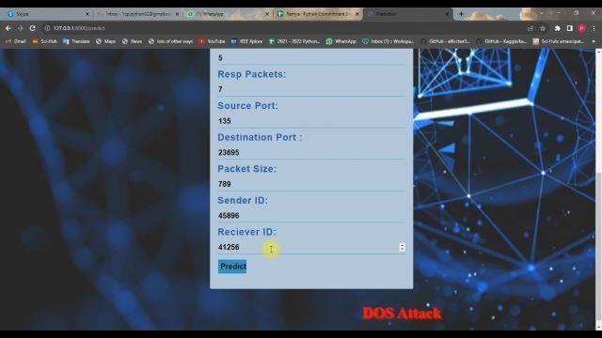
Results

Slide 23
Future Enhancement
Automated Response Orchestration: Integrate CTI mining with automated response orchestration systems to enable swift and coordinated actions in response to detected threats.
Enhanced Threat Intelligence Sharing: Facilitate seamless sharing of threat intelligence among organizations, industry sectors, and government agencies.

Slide 24
Conclusion
In a digital age marred by escalating cyber threats, our project's exploration of Cyber Threat Intelligence (CTI) mining offers a transformative solution. The integration of CTI insights empowers organizations to proactively identify emerging threats, profile hackers, and respond effectively.
The integration of CTI insights empowers organizations to proactively identify emerging threats, profile hackers, and respond effectively
As we bid farewell to conventional security paradigms, our project underscores the pivotal role of CTI mining in fortifying digital defenses and ushering in a new era of dynamic and proactive cybersecurity.
Our project is highly efficient and user-friendly

Slide 25
Reference Paper/ URL
[1] Sun, N., Ding, M., Jiang, J., Xu, W., Mo, X., Tai, Y., & Zhang, J. (2023). Cyber Threat Intelligence Mining for Proactive Cybersecurity Defense: A Survey and New Perspectives. IEEE Communications Surveys & Tutorials..
[2] R. McMillan. “Definition: Threat intelligence.” Accessed: Nov. 10, 2022.
[3] D. Shackleford, Who’s Using Cyberthreat Intelligence and How, SANS Inst., North Bethesda, MD, USA, 2015.
[4] H. Dalziel, How to Define and Build an Effective Cyber Threat Intelligence Capability, Syngress, Waltham, MA, USA, 2014.

